Slide 1

Customer strategy

Slide 2
Customer Strategy - Our Journey
Presented draft document to the Chief’s, received buy-in, support and feedback. Updated draft document.
Collaborated with the Customer Team, customers and created a draft document.
CEO
Presentation
04
02
03
Research
Presented draft document to Raveen, received buy-in, support and feedback. Updated draft document.
CHIEF
Presentations
01
Collaborate
Obtained industry research from AsiaPac, US and Europe.

Slide 3
Our existing state

Slide 4
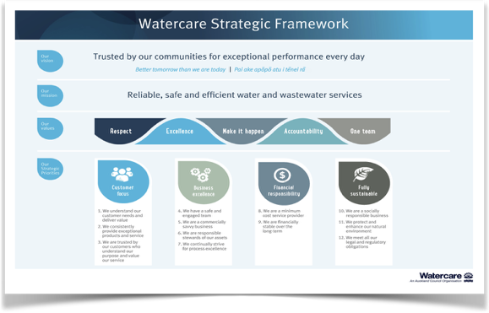

Our strategic framework
High Performing Team
Effective Processes
Technology Solutions

Slide 5
What industry challenges do we face?
Sustainability
Regulation
Water utilities have a responsibility to maintain and enhance the resiliency of vital ecosystems. Aucklanders share a strong concern about the future of Auckland, more specifically:
The health of its waterways and infrastructure;
The impact of population growth;
The affect of climate change and how this could contribute to water scarcity; and
What role they can play in improving water efficiency.
The New Zealand government is currently reviewing the water industry, this can:
Create uncertainty around proposed reforms;
Lead to significant change across four key areas - Oversight and regulation, funding and finance, transparency and accountability, capacity and capability of decision-makers and suppliers.
People and Infrastructure Resilience
Demand for, “smart water” solutions - monitoring, detecting and reducing leaks and overflows is growing. The water industry face the following challenges:
Utilities can lose up to 30% of their water supply through network leaks (globally);
Non-revenue water costs utilities up to $14 billion, per annum (globally); and
Only 42% of New Zealanders believe that water providers adequately maintain water supplies and assets.
Customers
Customers are now more informed and connected than ever before. Water utilities globally are expected to:
engage customers on their terms; and
Provide greater emphasis on innovation, transparency, adaptability (to their needs) and accountability.

Slide 6
Who are our customers and what are their expectations?
Domestic
Non-Domestic (Enterprise and SME’s)
Customer Expectations
I’m responsible for the health and safety of my household. I’m paying the bills. I need assurance that you’re looking out for me.
As an Enterprise customer I need assurance that our water and wastewater services will operate without disruption.
Customer Expectations
Customer Expectations
Be easy to deal with. Enable me to engage and interact with you across my preferred communication channels;
Provide me with simple options to pay my bill, if I’m struggling to pay on time;
Respond to my problems and resolve them as quickly as possible;
When I have to interact with you provide me with effortless experiences;
Tell me about your environmental and community activities, listen to me and always be there to help me;
I want to trust the quality of the water you provide.
Understand our business and let us interact with representatives who know us;
Always provide us with safe and high quality water;
Inform us if planned maintenance will impact our operations and when something goes wrong be transparent with resolution times;
Be excellent at what you do, so we can be great at what we do;
Enable the communities we serve to trust your water services.

Slide 7
How do our customers feel about us?
Watercare is recognised as an industry leader within the New Zealand water sector and has a strong record of successfully providing Aucklanders with reliable and safe water services. As a result Aucklanders are happy with their water. To build trust, further (positive) customer engagement is required.
Customer Perceptions
Promoter
Passive
)
Domestic
Non-Domestic
Domestic
Non-Domestic
76%
Provides high quality customer service.
81%
Customer service is consistently good.
47%
Keeps me informed of service interruptions, or changes.
53%
Always get accurate information and valuable advice.
Responds quickly to faults.
Strong commercial relationships.
42%
My water supplier is environmentally responsible.
45%
My water supplier is open and transparent.
69%
69%
Provides a reliable service.
67%
Responses are provided in a timely manner.
32%
Of New Zealanders believe water suppliers are helping them become more efficient.
35%
Processes are designed around what is best for the customer.
68%
60%
63%
Feel listened to and our business is well-understood.
Easy to deal with.
Data Source: Watercare Discovery Report - Senate SHJ July 2018

Slide 8
Our relationship needs to evolve.
Account relationships are structured around an asset (water meter) and a bill. Creating customer relationships and maintaining data integrity are key cornerstones to our long-term success.
Customer Relationships
1
2
1
3
Watercare Bill
Only 20% of customer records have accurate customer data.

Slide 9
How do our customers connect with us?
The communication channels Watercare offers customers today lean heavily towards Personal Care. By understanding customer channel preferences we will be able to consider, plan and implement additional channels that provide customers with greater choice and control.
Customer Engagement
Proactive Care
Self Care
Assisted Care
Adhoc Data Transfer
Personal Care
Press
1
Voice
Email
Customer Communications (Post or Drop Cards)
IVR (Payments)
Automated Payments
Channel Migration
Web Form
Fax
Website (My account)
Letter
Face to Face

Slide 10
How do we detect and resolve leaks?
Currently, Watercare is dependent on meter readers identifying high meter reads and leaving an information card in the letterbox of the customer. Or customers will identify and report a leak, or an overflow creating a reactive service delivery.
People and Infrastructure Resilience
Water Leaks and Wastewater Overflows
Leak Detection
1
2
1
3
High Water Consumption
Meter Reader
OR
Faults Team
(09) 442 2222
Customer

Slide 11
Are we ready for industry regulation transformation?
Regulation
#1
Universal Treatment of drinking water;
#2
Establish an independent drinking water regulator;
#3
Stronger laws and regulation to enforce standards;
#4
Establishing dedicated water suppliers; and
Amending the resource management act on standards and sources of drinking water.
#5

Slide 12
Water for life, let’s create a healthy and more sustainable environment for all Aucklanders!
#1
Reduce water usage (target 15% by 2025);
Sustainability
#2
Promote water efficient products to customers;
Work with communities to educate and empower water efficient practices;
#3
Leverage innovation and technology to drive network leak detection programmes;
#4
Working with Council to proactively lead water optimisation, reduce trade waste and create healthier waterways.
#5

Slide 13
Customer of the future

Slide 14
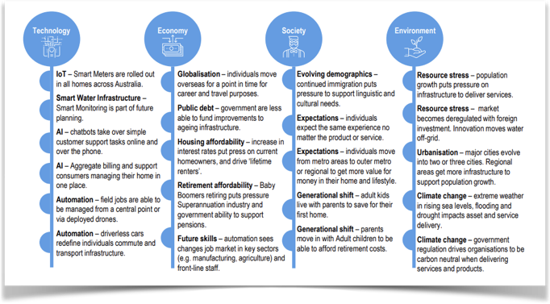
Mega trends that may influence our customers and our business.
Data Source: WSAA - The Customer of the Future KPMG Feb 2018

Slide 15
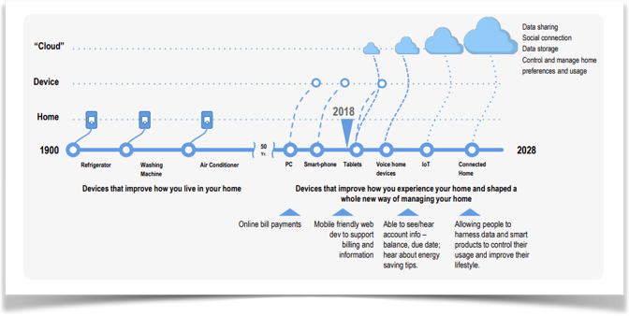
Devices are becoming more central to how we manage our lives.
Gartner is predicting a typical family home could contain more than 500 connected devices by 2022, while right now most consumers see the connected home as a nebulous term with no clear value proposition.
Data Source: WSAA - The Customer of the Future KPMG Feb 2018

Slide 16
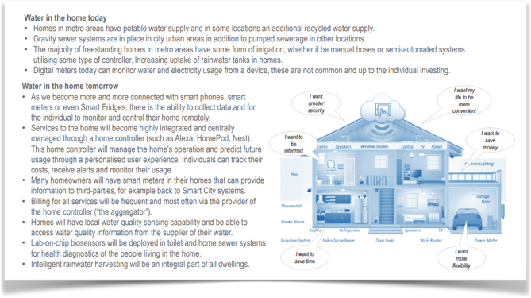
Water and the connected home.
Data Source: WSAA - The Customer of the Future KPMG Feb 2018

Slide 17

Understanding the role of water in the home.
It’s all about me, my life, my wallet
MY WALLET
How I adjust my share of wallet across life events
MY WATCH
How I balance my time constraints through my life stages
MY CONNECTION
How I connect to devices, information and with others
MY MOTIVATION
How my characteristics drive my behaviour and expectations
!
MY ATTENTION
How I direct my attention and focus
Data Source: WSAA - The Customer of the Future KPMG Feb 2018

Slide 18
The 5 MY’s and Future Customer Expectations
MANAGING MY HOME
(My wallet and time)
Water is not in the forefront of how households manage their lives;
It is seen as an expense and a burden to act on in times of a water crisis;
Individuals interact with water everyday with an unspoken trust; and
Looking forward we need to leverage this trust to provide more focused experiences and support to individuals and communities.
SUPPORTING MY LIFE
(My attention and motivation)
Water is a source that is taken for granted until there is an issue;
When there’s a water crisis, communities will rally around the call for action for the greater good; and
Going forward, people want to be both educated and rewarded for sustainable water behaviours.
CONNECTING WITH ME
(My connection)
New devices and tools are gaining more users in less time;
As a result of increased connectivity, customers have more digitally “connected” expectations;
To meet these needs, we may have to align with 3rd parties to enrich our data; and
Our focus should be to use technology to best support, educate and engage now and in the future.
CVP = RELIABLE SERVICE + COST SAVINGS + CONNECTING WITH THE INDIVIDUAL + SUSTAINABLE FUTURE
Data Source: WSAA - The Customer of the Future KPMG Feb 2018

Slide 19
Delivering customer value.
Global value proposition
RELIABLE SERVICE
COST SAVINGS
CONNECTING WITH THE INDIVIDUAL
SUSTAINABLE FUTURE
Instil customer centric thinking and behaviours as core part of Watercare’s DNA. | Aggregate service interactions with other providers related to the home to allow the individual to manage bills from one platform. | Develop a customer intelligence approach to get insights to constantly improve customer experience. | Help individuals understand the impact of their actions, covering key themes like – Water efficiency; Affordable pricing options; Incentives and rebates; Sustainable habits; Local initiatives in their area.
Work collaboratively to harness relevant insights from data. | Provide flexible payment options as well as incentives and rebates to allow individuals to manage their wallets easily. | Use AI to enhance insights on our customers by continually improving our data. | Partner with organisations for outreach and action in the community – Local retail (e.g. home improvements); Education institutions; Local community groups.
Prepare for ever increasing customer expectations through human-centred techniques like design thinking. | Be transparent of pricing and costs. | Create a social connection for targeted audiences. | Continue to give individuals a voice in planning future infrastructure initiatives.
Data Source: WSAA - The Customer of the Future KPMG Feb 2018

Slide 20
Future customer personas.
Considering an individual’s relationship with their community and how they manage their homes.
Proactively Managing Home
Individuals who proactively manage their household bills through automated payment options and invest in services or products to reduce consumption, driven by cost and/or sustainability.
Community Engaged
Individuals who are actively engaging with the community they live in through environmental, social and political measures.
Actively Managing Home
Individuals who manage their bills to ensure they are paid on time and choose to make the payment themselves once the bill has arrived.
Inwardly Focussed
Individuals who are interested in things that directly impact themselves and/or their social network (friends and family).
Reactively Managing Home
Individuals who manage their bills and other household purchases/services as needed. These individuals may be likely to default.
Data Source: WSAA - The Customer of the Future KPMG Feb 2018

Slide 21






What’s important to our customers and how are they managing their home?
Reactively managing home
Actively managing home
Proactively managing home
Spends money as required
Manages to a budget
Invests to see long-term return
Ruby, 72 “Stable and Secure”
Kim, 32 “Open Opportunist”
Tracey, 44 “Family Matters”
Community Engaged
Actively involved in making an impact to the wider community.
Jennifer, 26 “Mindful Millenial”
Jim, 60 “Lifestyle and Leisure”
Tim, 30 “Success Seeker”
Inwardly Focussed
Focused on their family and friends, make small actions on a larger scale.
Data Source: WSAA - The Customer of the Future KPMG Feb 2018

Slide 22
What do our customers need?
Jennifer, 26 “Mindful Millenial”
Tim, 30 “Success Seeker”
Tracy, 44 “Family Matters”
Jim, 60 “Lifestyle & Leisure”
Ruby, 72 “Stable & Secure”
Kim (32) “Open Opportunist”
Know me and let me know you;
Give me a voice, make me proud of my city;
Help me reduce my consumption and costs.
Give me data and educate me to effectively manage my consumption;
Anticipate my needs;
Make it easy for me and respect my limited time.
Educate me on water efficiency to reduce my costs;
Give me data, so I can educate my kids on the impact of their behaviours and actions.
As a renter I feel vulnerable
I want to be in control of my money
As an immigrant my community is very important
Mobile apps make my life much easier
Support me in reducing costs as I move into retirement;
Allow me to manage costs all in one place.
Support me so I don’t lose my independence;
Give me a voice so I can educate my grand children on smart water ways.
Data Source: WSAA - The Customer of the Future KPMG Feb 2018

Slide 23
How can we support the future needs of our customers?
Jennifer, 26 “Mindful Millenial”
Tim, 30 “Success Seeker”
Tracy, 44 “Family Matters”
Jim, 60 “Lifestyle & Leisure”
Ruby, 72 “Stable & Secure”
Kim (32) “Open Opportunist”
Create a connection;
Educate on a 1:1 basis;
Support home management.
Provide real-time data;
Enrich data to model behaviours.
Incentivise and reward based upon efficiencies gained;
Provide real-time data.
Help her understand her rights as a renter
Provide suitable payment options
Demonstrate support for her community
Support home management;
Bundle for savings;
Tailor billing options for the individual.
Tailor billing options for the individual;
Create a connection.
Data Source: WSAA - The Customer of the Future KPMG Feb 2018

Slide 24
Our customer strategy

Slide 25
Our strategic framework
High Performing Team
Effective Processes
Technology Solutions

Slide 26
We provide great value to our customers by connecting with the individual, providing affordable and reliable services to enable a sustainable future.
Our strategic priorities
We understand our customer needs and deliver value;
We consistently provide exceptional products and service;
We are trusted by our customers who understand our purpose and value our service.
Customer focus
Customer expectations
Developer
AVAILABILITY
RELIABILITY
AFFORDABILITY
CONNECTABILITY
SUSTAINABILITY
Our customers
Commercial
Communities
Customer experience
ONE BRAND
SEAMLESS
FRICTIONLESS
PERSONALISED
ENGAGED
SME
Consumer
by being…
#1
#2
#3
#4
#5
Achieve
Customer Centric
Digital First
Flexible & Agile
Caring & Nurturing
Insight Led
#1
#2
#3
#4
#5
Focus
what’s next?
CX Design
Technology Enablement
Continuous Improvement
Employee & Partner Engagement, Wellbeing & Safety
Operational Excellence

Slide 27
What objectives do we need to focus on to satisfy the needs of our customers?
Develop for tomorrow, while meeting my needs today;
Demonstrate that you know me;
Enable me to engage and interact with you across my preferred communication channels;
My previous interaction history, regardless of channel are recorded;
Communicate with me when you have issues preventing me from conducting my business with you.
Build a culture that prioritises me over assets, or bare minimum requirements;
Respond to my problems and resolve them as quickly as possible;
Maintain your network to minimise faults.
Strategic Objectives
Availability
reliability
sustainability
Remove the need for me to contact you, anticipate my information needs and address them proactively;
Understand our business and let us interact with representatives who know us;
Provide advance notice of outages and progress updates;
Capture and utilise real time data from the field to identify new issues;
Predict potential issues and maintenance needs;
Be easy to deal with.
I need assurance that you’re looking after me;
Provide me with simple options to pay my bill, if I’m struggling to pay on time;
Notify me of high usage as it happens;
Provide me with billing options.
affordability
CONNECTABILITY
Enable the communities we serve to trust your water services;
Protect our environment as you complete infrastructure projects;
Educate us about your social license and how we can become more water efficient.

Slide 28
Contribute to the creation of a customer-centric culture at Watercare.
Build a culture that prioritises me over assets, or bare minimum requirements.
With a customer led approach we will always take an, “outside in” view of how Watercare operates and functions. Prioritising the needs of the customer is vital, however the needs of our customer facing employees are just as important. Taking both parties on a transformational journey will enable us to realise continuous improvement.
reliability
Customer Expectation
Strategic Objective
Customers and review feedback, identify successes and failures.
Customer journeys with customers.
Customer feedback and incorporate in future design.
engage
design
Define and prioritise business improvement initiatives.
collect
Focus
Key metrics to understand the levers for success.
measure
plan
Prioritise process, people and technology enablers that will accelerate efficiency.
Customer-Centric Culture
implement
Refine
People and technology enablers in an agile way, where progressive improvement is valued over postponed perfection.
collaborate
Operating models and channel strategy.
Leverage the diverse inputs from cross functional teams.

Slide 29
Review the existing operating models of our customer facing teams.
An operating model review with a, ‘set of fresh eyes’ can identify operational pain points. We will focus on eliminating our pain points to continuously improve our customer experience.
reliability
Customer Expectation
Respond to my problems and resolve them as quickly as possible.
Strategic Objective
Understand our customers needs and document customer journeys;
#1
#2
Identify pain points and prioritise quick wins;
Identify people and technology enablers that drive process efficiency;
#3
Create an implementation roadmap to enable team functions to be transformed.
#4

Slide 30
Create a single view of the customer.
Transforming our customer model will enable Watercare to obtain a single view of all customer information, creating more proactive and personalised customer experiences.
Customer Expectation
Develop for tomorrow, while meeting my needs today.
Availability
Strategic Objective
Data Integrity
Customer Contact Data
Alias and Trading Name
Customer Model Transformed
Billing Account
Roles
Point of Contact
Notification
Relationship Management

Slide 31
Reviewing our existing customer segmentation will enable us to obtain a deeper understanding of who our customers are.
An opportunity exists to expand upon our existing customer segments, restructure our data, collect customer insights and engage with customers to educate and empower. Creating a segmented service will enable us to prioritise, “High Value” customers.
Availability
Customer Expectation
Demonstrate that you know me.
Strategic Objective
Segmented Service
Customer Segmentation
Customer Segments
Define Segment
Developer
Commercial
Consumer
Communities
Identify Customer
SME
Customer Data
Data Preparation
Collect
Cleanse
Maintain
Migrate
Prioritise Customer
Customer Insights
Profile Segment
Survey and Respond
Analyse
Report
ImplementChange
Route Customer
Create Segment Strategies
Customer Experience
Design
Communicate
Serve
Sell

Slide 32
Co-design journeys with customers to create relevant and personalised customer experiences.
My previous interaction history, regardless of channel is recorded.
To create an omni-channel customer experience, Watercare needs to enable customers to transition, ‘seamlessly’ from one channel to another, so they can transact utilising, ‘frictionless’ processes.
Availability
Customer Expectation
Strategic Objective
Enable Customers to transact effortlessly.
Provide customers with greater choice and control.
Digital channels to consider:
Customer Surveys
IVR
Proactive SMS
Live Chat
Mobile App
Chatbot
Digital Employee
Connect existing customer touch points
Social Media
Website
Digital tools to consider:
Co-design customer journeys to create personalised experiences
Smart Meters
Marketing Automation
Speech Analytics
Predictive Analytics
Face2Face
Customer
email/ WebForm
Case Management
CTI
Dynamic Routing
Gamification
Voice
A one brand and Omni-channel experiences
32￼

Slide 33
We need to establish the communication channels our customers prefer?
Enable me to engage and interact with you across my preferred communication channels.
Offering customers their preferred channels will provide them with greater choice and control. A, “Digital First” approach will enable customers to connect on their terms and obtain the content they require from any location, on any device at any time.
Availability
Customer Expectation
Strategic Objective
Consider offering
Enhance channel
Proactive Care
Self Care
Assisted Care
Personal Care
Press
1
IVR
Website
Automated Payments
Seamless Data Transfer
Voice
Email
TXT SMS
Mobile App
Social Media
Mobile App
Chatbot
Face2Face
Live Chat
Video
Digital Employee
High emotion and complex customer interactions
Social Media

Slide 34
Customers enjoy having greater choice and control, providing additional payment options will provide greater flexibility.
Transitioning customers to ebill will reduce cost. Migrating customers to automated payment options makes it simple for customers to pay their bill. Introducing, smooth pay takes the uncertain seasonal spikes away, making it easier for customers to make regular and timely payments.
Affordability
Customer Expectation
I need assurance that you’re looking after me.
Strategic Objective
Strong focus on migrating customers away from paper bills to ebill. Target - to have 50% of customers on ebill by 30June 2019. Acquire & cleanse customer data at every touch point;
Migrate customers to automated payment mechanisms - direct debit, or direct credit and apple pay;
Investigate the creation of alternate billing mechanisms - Smooth Pay, Time of Day, Prepaid and Time of Use;
Introduce leak insurance.

Slide 35
Customers are people, just like us. Lets engage and reassure them that we’re as passionate about the environment as they are!
Enable the communities we serve to trust your water services;
Protect our environment as you complete infrastructure projects;
Educate us about water efficiency.
Marketing automation will enable us to create customer groups and automatically supply them with personalised communication threads about water efficiency, projects, or events they’re passionate about.
sustainability
Customer Expectation
Strategic Objective
Social media is a great platform for this, as we can post videos, photos, collateral, or, “above the line” marketing pieces. Facebook, Twitter and LinkedIn should be considered.
Marketing automation
Social Media
Lets share our unique sustainability stories with customers and build community trust.
community events & environmental outcomes

Slide 36
Utilise insights and co-design effortless experiences with our customers.
Enable customers to rate and comment on their experiences. Engage and interact with customers to identify and eliminate pain points, enabling Watercare to provide all customers with effortless experiences.
CONNECTABILITY
Customer Expectation
Give me a voice and make me proud of my city.
Strategic Objective
Voice of the Customer (VoC) Programme
Customer Workshops
I love Watercare
Design Thinking
It took you 6 attempts to fix my fault.
You fixed my fault quickly, but then you overcharged me.

Slide 37
Our people are our greatest asset, lets keep them safe and work with them to identify and eliminate the enemies of employee engagement!
Ensure health and safety standards are being adhered to, this will enable us to continuously reduce workplace accidents and injuries. Regularly survey our employees, providing them with an opportunity to share with us their thoughts, views and opinions. This will provide the organisation with the opportunity to identify and eliminate the, ‘enemies of engagement’.
CONNECTABILITY
Customer Expectation
Be easy to deal with.
Strategic Objective
I wish I could wear casual clothes!
I really feel isolated from my team!
My boss throws me in at the deep end!
My boss takes me for granted!
I’m bored & I find this job tedious!
My work environment is dull, grey & boring!
There are too many rules in this job!
What’s the next step in my career!

Slide 38
Embrace and invest in technology to proactively identify leaks, automate processes to inform customers and set accurate expectations.
Capture and utilise real time data from the field to identify new issues;
Advise customers of local issues and resolution timeframes;
Predict potential issues and maintenance needs.
Utilising leak/damage detection sensors and smart meters across the 5G network will enable Watercare to receive leak data in real-time. Transmitting visual images to a GIS application within the Nerve Centre, where customer expectations can be set and managed by a single customer service representative from start to finish.
CONNECTABILITY
Customer Expectation
Strategic Objective
#1
Smart Meter detects leak
Nerve Centre CSR is notified of a P1 at 13 Bank Street. The CSR can see that Truck 1 is 5 min away & will attend the fault. Once job is allocated the customer is notified. Nerve Centre CSR prepares to answer a call from the customer.
The Nerve Centre can see that Truck 1 is very close to the incident via its eRoad application. The job is allocated to Truck 1.
#4
Customer Mobile App
Smart Meter transmits location & severity of leak. Sends notification to Nerve Centre, via 5G network. At the same time the customer is notified.
#3
#2
The traffic management team arrive and take control of the hazard. Neighbours who live in the area are automatically notified about the incident.
#5
Leak Detected
Geographical Information Systems
Job Created
Truck 1
Hazard in your neighbourhood. Traffic management have arrived.
Smart Meter
Leak Detected
P1 - 13 Bank Street
Work Crew ETA to site: 30 min
Truck 1 - 30 min
Work Crew ETA to site: 5 min
Hazard Management
Traffic Management
Nerve Centre CSR
5G Network

Slide 39
Customer Metrics and Implementation Roadmap

Slide 40
Customer Metrics
Customer Satisfaction
Net Promoter Score (NPS)
Digital Interactions
Voice Interactions
Transactional Net Promoter Score (tNPS)
Cost per Digital Interaction
Grade of Service - Voice Interactions
Cost per Voice Interaction
Trust Index
Customer Interaction - % Digital
Abandonment Rate - Voice Interactions
Fault Response Times
Fault/Maintenance Interactions
Customer Effort Score (CES)
Grade of Service - Digital Interactions
Abandonment Rate - Digital Interactions
Proactive Digital Alerts - Average time to Pay
Cost to serve (Market Segment)
Complaint Resolution
General

Slide 41
Implementation Roadmap
Strategic Priorities
Q1
Q2
Q3
Q4
Customer Journey Mapping (Co-designed with customers)
Operating Model Review (Customer Facing Teams)
CX Design
Billing - STP squad (The Incredi-bills)
Metering & Connections - STP squad (The Dare Devels)
Live chat
Technology Enablement
Customer Comms - STP squad (Mod Comms)
Predictive analytics
Investigate digital channels & tools - Complete option assessments
Business improvement programme (100 Dumb things - Tactical opportunities)
eBill Campaign (Transition from paper bill to ebill)
Continuous Improvement
Channel Migration (Transition Personal Care interactions to Proactive, Self and Assisted Care channels)
Health and Safety (Thriving employees)
eNPS Survey
Employee Engagement, Wellbeing & Safety

Slide 42
VoC programme

Slide 43
Background
Watercare is committed to becoming a customer centric organisation and has made customer focus one of its four strategic priorities.
Customer focus is our key strategic priority:
Our strategic priorities
We understand our customer needs and deliver value;
We consistently provide exceptional products and service;
We are trusted by our customers who understand our purpose and value our service.
Customer focus
Voice of the customer plays a key role in understanding customer needs, pain points and moments of truth that we can use to develop insights to deliver seamless customer experiences.

Slide 44
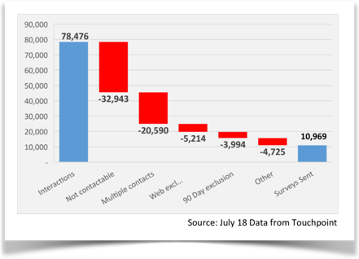
Our current VoC construct is complex and rendering low survey volumes and insights.
Pain Points (existing state)
Limited customer information and survey rules impact sample sizes.
Low sample size due to contact information and frequency of rules applied - ~10K sample size despite ~30K calls received per month;
Currently, 5 days delay from interaction before survey is sent, with no closing date;
Low response rate due to complexity of survey and questions - ~1K per month;
Five different survey types with up to 20 questions;
Closed loop process is optional and is determined on a, ‘case by case’ basis with no root cause monitoring;
Around ~3K verbatim per month being analysed manually, on an adhoc basis;
Web survey currently captured by a comment field.

Slide 45
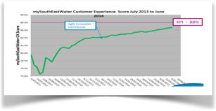
NPS or service experience; which resonates better with our customers and aligns with our vision.
VoC survey needs to align with our vision.
Trusted by our communities for exceptional performance every day!
Not a reflection on Watercare’s service , simply not likely to talk about a water service company with my friends.
Our customers don’t see the relevance of the NPS score:
      13% of customers who responded felt this was not a measure they could relate to.
As a family we tend to not talk about Watercare.
I don’t understand this question to give an answer, as I don’t know of any alternatives for water service providers.
Funny question given we don’t have any other options for our water supply!
Customer experience score aligns better to exception performance every day and in turn, drives trust.

Slide 46
Revise survey to capture better insights
Simplified survey and questions to align
Clearly defined loop to drive more insights
Simplify survey to drive less customer effort;
Revise rule to increase sample size;
Prescribe case management on strong detractors to drive continuous improvement;
Design a closed loop process to identify root cause;
AI based TXT analytic tool be implemented to analyse verbatim and high light key themes;
Interactive web survey to be developed at each stage of CX journey.
Calls and emails
Service request is raised capturing contact email & mobile
Report
Monitor, learn and improve
Customer Survey
Triggered via TXT, or email
#6
#1
#5
#2
#4
#3
Call Back
Strong Detractors
Identify root cause within SLA
Request call back
Case Management
Assigned to VoC champion in each department

Slide 47

Next Steps…
Objectives are to increase sample size and capture better quality feedback to drive insights:
Test new simplified survey as proof of concept and assess results;
  Capture both NPS and Overall service experience score to determine which score has higher engagement with our customers.
Exemption rules to be changed to <30 days across all interaction. Existing rules are prohibitive to increasing sample size;
  All contacts >30 days, rather than 90, and in some instances 365 days;
  Mandate capture of customer email and mobile on service requests.
Implement an interactive website survey to identify key pain points in CX journey;
Implement case management with strong detractors and customers requesting contact in Mod Comms stream to report and monitor root cause;
RFP to identify TXT analytics tool that best meets our needs;
Implement regular reporting dashboards with insights and deep dives into relevant areas on a regular basis.

